Slide 1

Sprocket Central Pty Ltd
Data analytics approach
[Muomah Maureen]

Slide 2
Agenda
Introduction
Data Exploration
Model Development
Interpretation

Slide 3
Introduction
Identify and Recommend the Top New Customers to Target from Datasets
Outline of Problem
Sprocket Central is a company that specializes in high-quality bikes and cycling accessories
Their marketing team is looking to boost business sales by analyzing provided datasets.
Using the three datasets provided, the aim is to analyze and recommend customers out of the 1000 New customers Sprocket Central should target.
Content of data analysis
Old customers distribution
Job industry distributions
Wealth segmentation of customers
Distribution of customers by age groups
Distribution of customers by State
Bike related Purchases over the last three years by gender
RFM analysis and customer classification.

Slide 4
Data Exploration
Data Quality Assessment
.
Key Issues dealt with for the data quality issue:
Customer Demographic | DOB: Inaccurate Age: Missing | Job Title:Blanks Customer ID: Incomplete | Gender: Inconsistent | Deceased customer: Filtered out | Default column: Delete
Customer Address |  | CustomerID: Incomplete | State: Inconsistent
Transactions | List price :Missing | CustomerID: Incomplete Online orders:Blanks Brands: Blanks |  |  |  | List price:Format product sold Date: Format(Filtered out)
Accuracy
Completeness
Consistency
Currency
Relevancy
Validity

Slide 5
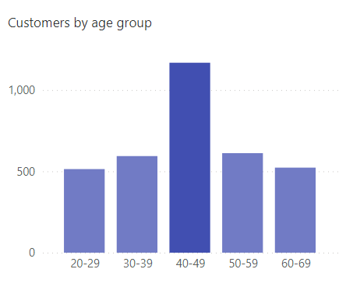
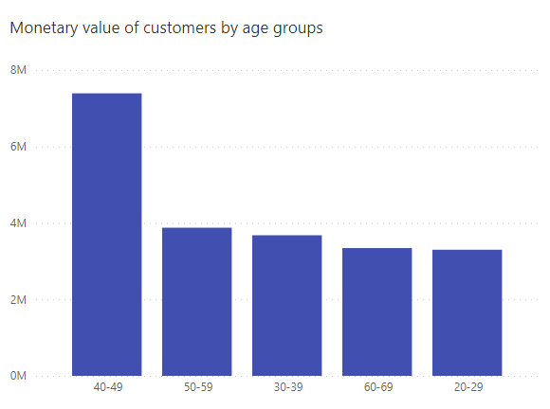
Data Exploration
Old customers age distribution
Data shows most of the customers fall within the age bracket of 40-49.
Data(second chart) also shows that customers within the 40-49 age group have the most monetary value in the company accompanied by those within the 50-59 age group and the least 20-29.

Slide 6
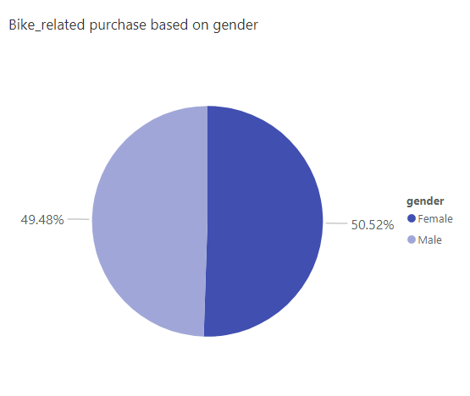
Data Exploration
Old customers gender classification based on past 3 years bike related purchases
Data shows on average, females have made more bike related purchases in the last 3years compared to the males.
On average, Females have had 1% higher bike related purchase compared to men in the last 3 years.

Slide 7
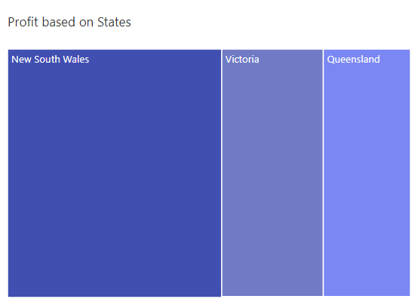
Data Exploration
Customer classification in States by profit
Data shows that customers in New South Wales spend more money in bike purchases.

Slide 8
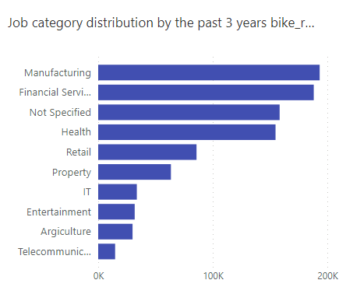
Data Exploration
Job category distribution
The data shows that old customers in the Manufacturing, Financial services and Health industries have made the most bike-related purchases in the past 3 years.

Slide 9
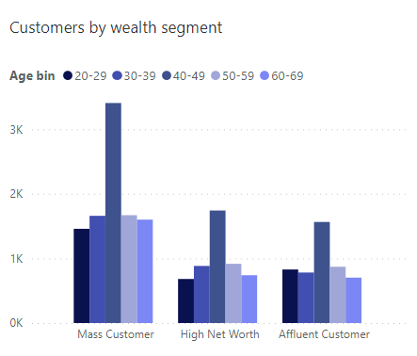
Data Exploration
Wealth segmentation by age category
The data shows majority of the old customers are Mass customers.
The next category is the High Net Worth.
The Mass customers comprise mainly of those within the age group 40-49 followed by 30-39.

Slide 10
Model Development
RFM Analysis and Customer classification- Targeting High value(Platinum customers)
The RFM in RFM analysis stands for Recency, Frequency and Monetary value. RFM analysis is a way to use data based on existing customer behaviors to predict how a new customer is likely to act.
RFM analysis is used to determine which customers a business should target to increase its revenue and revenue.
The RFM model shows customers that have displayed high levels of engagement with the business in the three categories mentioned above.

Slide 11
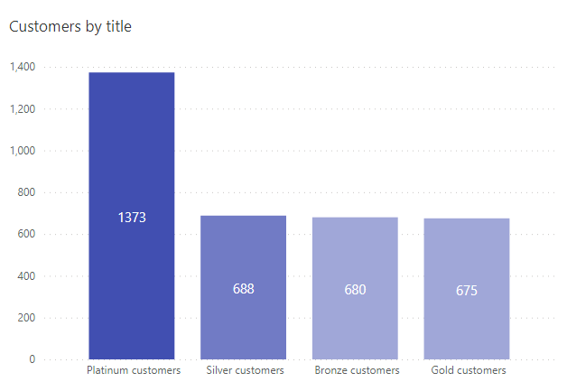
Model Development
RFM Analysis and Customer classification- Targeting High value(Platinum customers)
In the RFM analysis model, the old customers were grouped into 4 “Platinum”, “Silver”, Bronze” and “Gold” accordingly.
The Platinum customers are those who had RFM scores of 411-555. They had the highest recency scores.
They made up the majority of the old customers.
The Platinum customers are those who the company should target among the New customers.

Slide 12
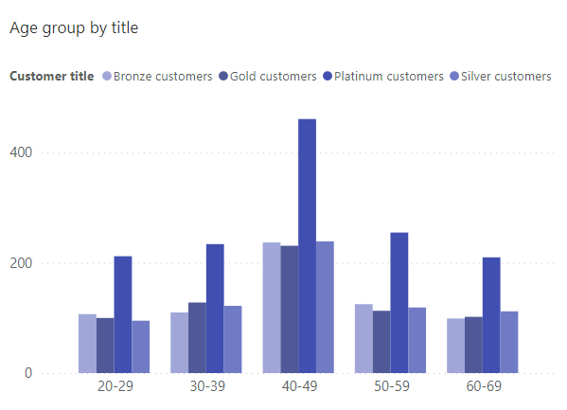
Model Development
RFM Analysis and Customer classification- Targeting High value(Platinum customers)
The data shows that the highest number of platinum customers were found within the 40-49 age group.
The next category is the 50-59 age group.

Slide 13
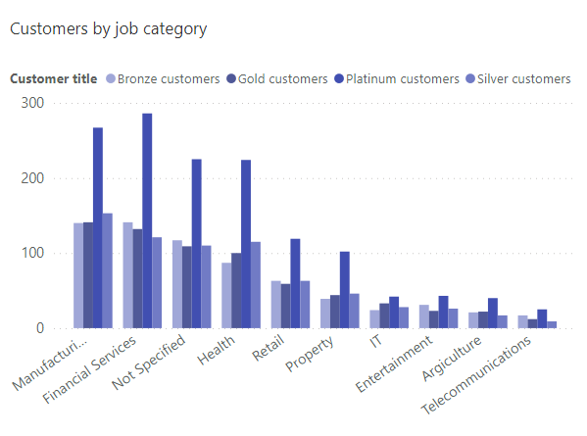
Model Development
RFM Analysis and Customer classification- Targeting High value(Platinum customers)
The data shows that the highest number of platinum customers were found in the Financial Services industry.
The next category is the Manufacturing industry with a higher number of Silver customers than the Financial service industry.

Slide 14
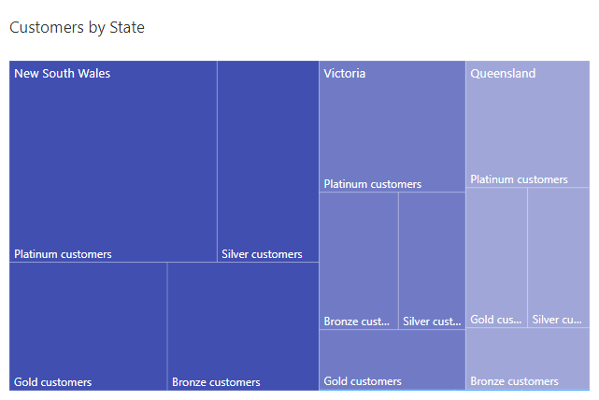
Model Development
RFM Analysis and Customer classification- Targeting High value(Platinum customers)
Customers in New South Wales(NSW) make up a large number of the Platinum customers.
Next are those in Victoria(VIC)

Slide 15
Model Development
RFM Analysis and Customer classification- Targeting High value(Platinum customers)
These are the Platinum(high value) customers that should be targeted from the New
list:
Most of the high value customers will be Female compared to the male.
Those working in the Financial services, Manufacturing and Health industries.
Aged between 40-49
Who are all currently Living in New south wales(NSW) and Victoria (VIC)
Who are in the Mass Customer wealth segment and High Net Worth

Slide 16
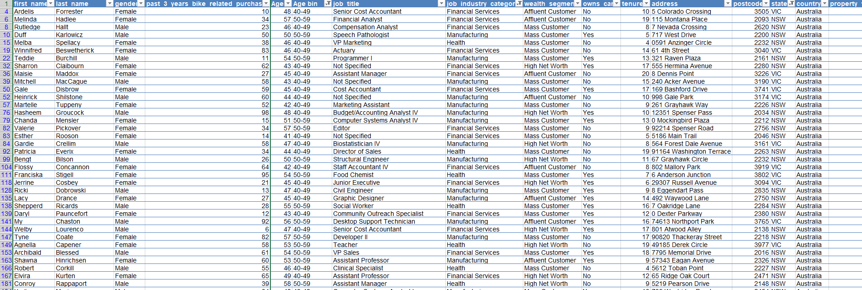
Interpretation
After filtering the New customer list to fit the RFM specifications, these are some of the New customers the company should be targeting:

Slide 17
Thank you

